Slide 1
MLOps I: Experiment Tracking and Regression Project Work

Slide 2

Learning Objectives
By the end of this session, participants should be able to:
Implement experiment tracking with MLflow
Version datasets with DVC
Work intensively on regression project

Slide 3
Part 1: Introduction to MLOps
1

Slide 4
Key Questions
By the end of this session, participants should be able to:
What is MLOps and why it matters
What does the ML lifecycle entail from experimentation to production?
What is the overview of MLOps tools and standard practices?
What are the reproducibility challenges in ML?
Discussion: Real-world MLOps scenarios

Slide 5

What is MLOps?
MLOps is not just another buzzword—it's the essential bridge that turns machine learning experiments into reliable, production-ready systems.
It combines DevOps practices with ML workflows to automate, scale, and maintain models in real-world use. In practice, MLOps ensures teams deliver faster, more trustworthy AI without the chaos of manual handoffs.

Slide 6
What is MLOps and Why It Matters?
MLOps stands for Machine Learning Operations, applying software engineering rigor to ML lifecycles, much like DevOps does for apps. It matters because:
80-90% of ML projects fail to reach production without it.
Silos between data scientists and engineers cause delays, errors, and drift.
Reliable MLOps cuts deployment time from months to days while keeping models accurate amid changing data.

Slide 7
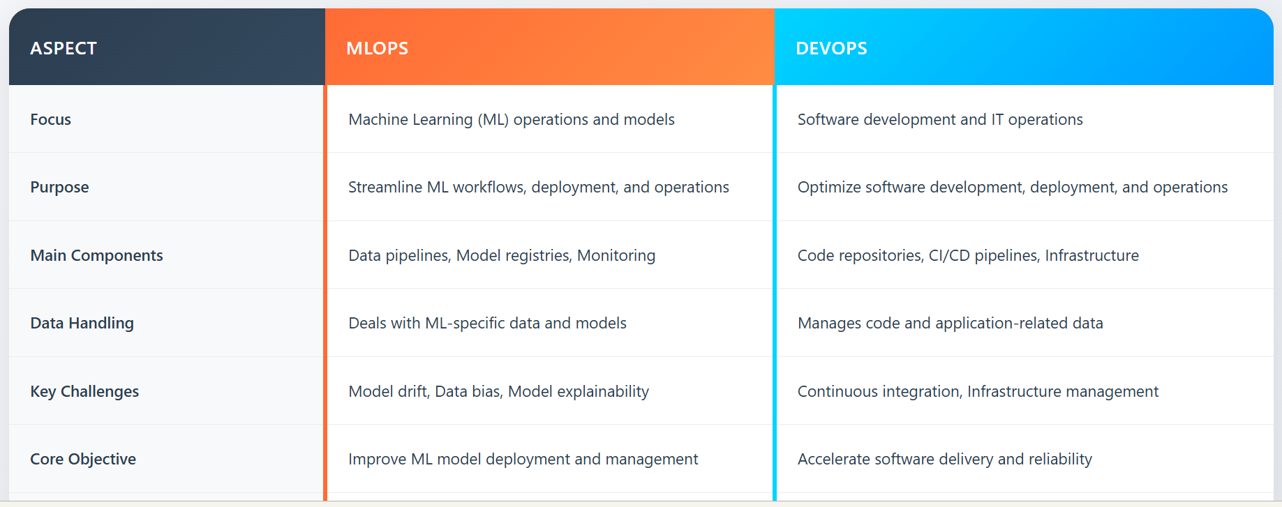
1
Key Concepts: Traditional MLOps vs. DevOps

Slide 8
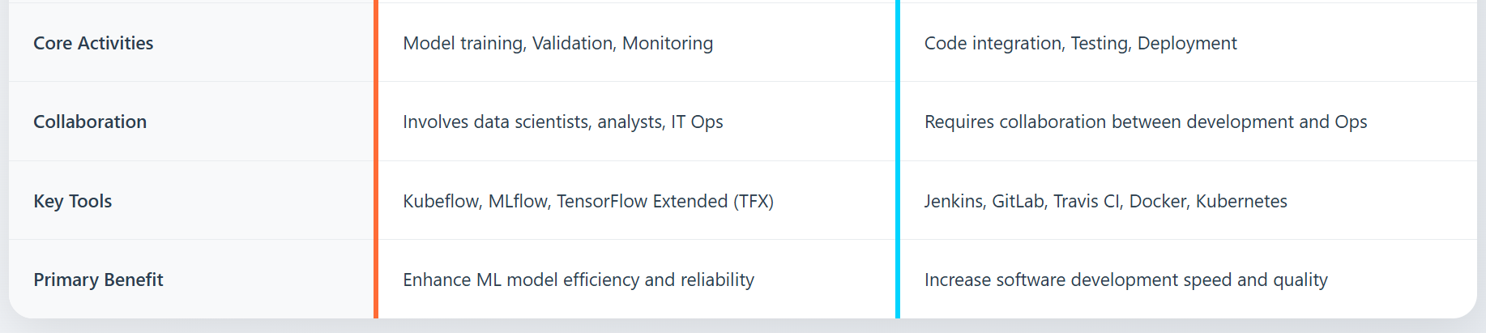
Key Concepts: Traditional MLOps vs.
DevOps

Slide 9
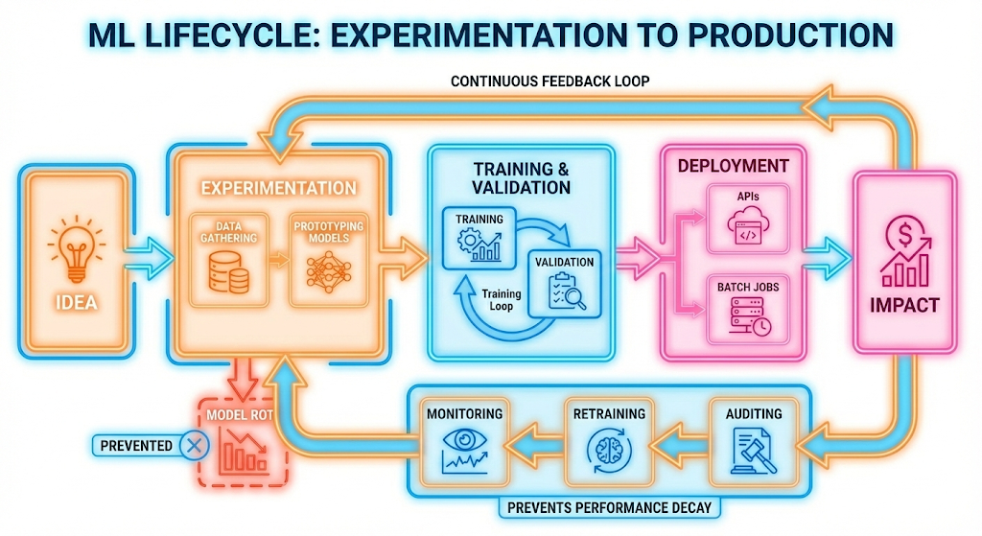

Slide 10
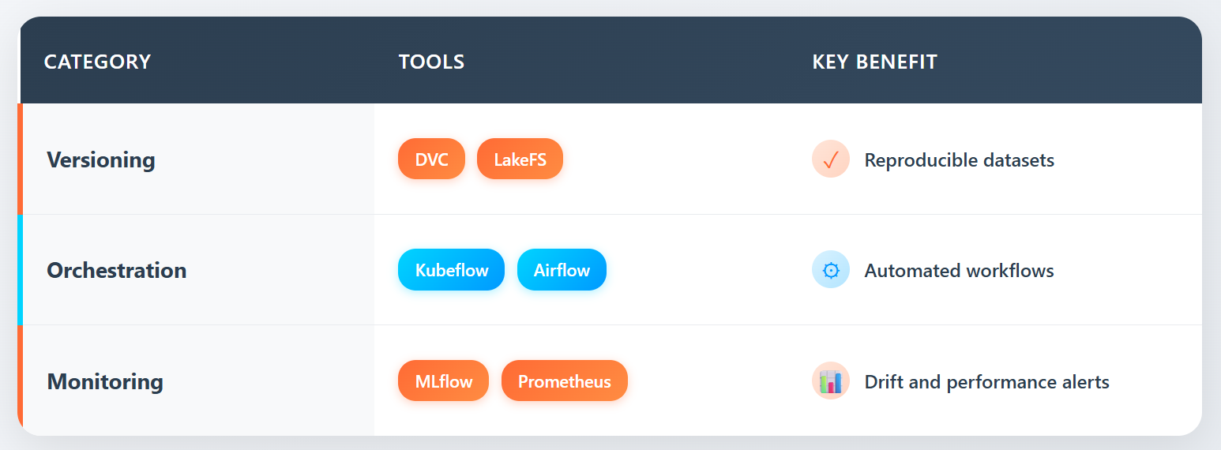
Overview of MLOps Tools and Practices
Narrow AI: Performs one defined task — e.g., detect malaria, read ECGs
General AI (AGI): Hypothetical — human-level intelligence (does not exist). Public fear comes from AGI, but public health uses only Narrow AI.

Slide 11

Reproducibility Challenges in ML
Data Drift Production data changes over time in unpredictable ways. A fraud detection model trained on 2023 patterns fails in 2024 when fraudsters change tactics. Like a diagnostic tool calibrated for one population failing in another demographic.
Model Versioning Multiple model versions run across services, but tracking which training data, code, and hyperparameters produced each version is lost. When debugging is needed, the exact conditions cannot be recreated. Like trying to recreate a medication batch without ingredient records.
Infrastructure Differences Models behave differently across environments. A model performs well on cloud GPUs but gives different predictions on edge CPUs due to quantization and hardware variations. Like medical procedures yielding different outcomes across facilities.
General AI (AGI): Hypothetical — human-level intelligence (does not exist). Public fear comes from AGI, but public health uses only Narrow AI.
Narrow AI: Performs one defined task — e.g., detect malaria, read ECGs

Slide 12

Reproducibility Challenges in ML
Dependency Conflicts Production systems freeze old library versions for stability, making retraining impossible. A 2022 model needs Python 3.8 and TensorFlow 2.8, but these conflict with current requirements. Like manufacturing drugs with discontinued equipment.
Feature Pipeline Brittleness Production features come from multiple microservices, each updating independently. Debugging a prediction fails because intermediate services have changed their logic since that prediction was made. Like diagnostic tests where each processing lab has updated its protocols.
Training-Serving Skew Features computed during training differ from serving. Models train on daily batch aggregates but serve real-time streaming data with different windows. Same input, different features, different predictions. Like guidelines from controlled studies failing in emergency conditions.
General AI (AGI): Hypothetical — human-level intelligence (does not exist). Public fear comes from AGI, but public health uses only Narrow AI.
Narrow AI: Performs one defined task — e.g., detect malaria, read ECGs

Slide 13
Reproducibility Challenges in ML
Non-Deterministic Operations Distributed training, async data loading, and thread scheduling create randomness beyond random seeds. Identical code and data produce different models across runs. Like manufacturing where temperature affects outputs despite identical steps.
Audit Requirements Regulations require reproducing past predictions, but models retrain, pipelines update, and logs rotate. A six-month-old loan rejection cannot be explained. Like justifying medical decisions after equipment recalibration and record archival.
Notes:
After you’ve spent so much money acquiring a customer, it’d be a shame if they leave. The cost of acquiring a new user is approximated to be 5 to 25 times more expensive than retaining an existing one. Churn prediction is predicting when a specific customer is about to stop using your products or services so that you can take appropriate actions to win them back. Churn prediction can be used not only for customers but also for employees.
To prevent customers from leaving, it’s important to keep them happy by addressing their concerns as soon as they arise. Automated support ticket classification can help with that. Previously, when a customer opened a support ticket or sent an email, it needed to first be processed then passed around to different departments until it arrived at the inbox of someone who could address it. An ML system can analyze the ticket content and predict where it should go, which can shorten the response time and improve customer satisfaction. It can also be used to classify internal IT tickets.

Slide 14
Real-world MLOps scenarios
What We Actually Use
• Search and Recommendations: Systems like Amazon and Netflix use ML to recommend items predicted to match user tastes. Netflix specifically measures its recommender system using a "take-rate" metric and links it to business goals like total streaming hours and subscription cancellation rates.
Fraud Detection: This is one of the oldest enterprise ML applications, where systems learn from historical data to predict if a future transaction is fraudulent.
Customer Support: ML is used to automatically classify support tickets, analysing content to route them to the correct department, which shortens response times and improves satisfaction.
System Reliability: Amazon experienced a significant outage on Prime Day when its autoscaling feature failed, illustrating the critical importance of robust resource management in production system.
Notes:
After you’ve spent so much money acquiring a customer, it’d be a shame if they leave. The cost of acquiring a new user is approximated to be 5 to 25 times more expensive than retaining an existing one. Churn prediction is predicting when a specific customer is about to stop using your products or services so that you can take appropriate actions to win them back. Churn prediction can be used not only for customers but also for employees.
To prevent customers from leaving, it’s important to keep them happy by addressing their concerns as soon as they arise. Automated support ticket classification can help with that. Previously, when a customer opened a support ticket or sent an email, it needed to first be processed then passed around to different departments until it arrived at the inbox of someone who could address it. An ML system can analyze the ticket content and predict where it should go, which can shorten the response time and improve customer satisfaction. It can also be used to classify internal IT tickets.

Slide 15
Real-world MLOps scenarios
What We Actually Use
• Search and Recommendations: Systems like Amazon and Netflix use ML to recommend items predicted to match user tastes. Netflix specifically measures its recommender system using a "take-rate" metric and links it to business goals like total streaming hours and subscription cancellation rates.
Fraud Detection: This is one of the oldest enterprise ML applications, where systems learn from historical data to predict if a future transaction is fraudulent.
Customer Support: ML is used to automatically classify support tickets, analysing content to route them to the correct department, which shortens response times and improves satisfaction.
System Reliability: Amazon experienced a significant outage on Prime Day when its autoscaling feature failed, illustrating the critical importance of robust resource management in production system.
Notes:
After you’ve spent so much money acquiring a customer, it’d be a shame if they leave. The cost of acquiring a new user is approximated to be 5 to 25 times more expensive than retaining an existing one. Churn prediction is predicting when a specific customer is about to stop using your products or services so that you can take appropriate actions to win them back. Churn prediction can be used not only for customers but also for employees.
To prevent customers from leaving, it’s important to keep them happy by addressing their concerns as soon as they arise. Automated support ticket classification can help with that. Previously, when a customer opened a support ticket or sent an email, it needed to first be processed then passed around to different departments until it arrived at the inbox of someone who could address it. An ML system can analyze the ticket content and predict where it should go, which can shorten the response time and improve customer satisfaction. It can also be used to classify internal IT tickets.

Slide 16
Experiment Tracking and Data Versioning
Why We Keep Track of Experiments
Introduction to MLflow
MLflow is an open-source model store and experiment tracking tool. It allows teams to track model artifacts during deployment and provides a shared infrastructure for managing model versions.
Experiment Tracking
Log and compare parameters, metrics, and results across experiments
Model Deployment
Deploy models to various serving platforms with consistent interface
Model Registry
Centralized store for managing model versions and transitions

Slide 17
Experiment Tracking and Data Versioning
Introduction to MLflow
MLflow is an open-source model store and experiment tracking tool. It allows teams to track model artifacts during deployment and provides a shared infrastructure for managing model versions.
Experiment Tracking
Log and compare parameters, metrics, and results across experiments
Model Registry
Centralized store for managing model versions and transitions
Model Deployment
Deploy models to various serving platforms with consistent interface
Shared Infrastructure
Team collaboration through standardized tracking and versioning

Slide 18
What to Log in MLflow
Parameters
Metrics
Visualizations
Loss curves, confusion matrices, feature importance plots
Model Files
Serialized models, weights, configurations
Learning rate schedules
Batch sizes
Number of epochs
Gradient norms
Weight decay values
Model architecture configs
Training & validation loss
Accuracy scores
F1, Precision, Recall
ROC-AUC curves
Custom business metrics

Slide 19
What to Log in MLflow
Visualizations
Loss curves, confusion matrices, feature importance plots
Visualizations
Loss curves, confusion matrices, feature importance plots
Logs & Reports
Evaluation logs, training summaries, intermediate results.

Slide 20
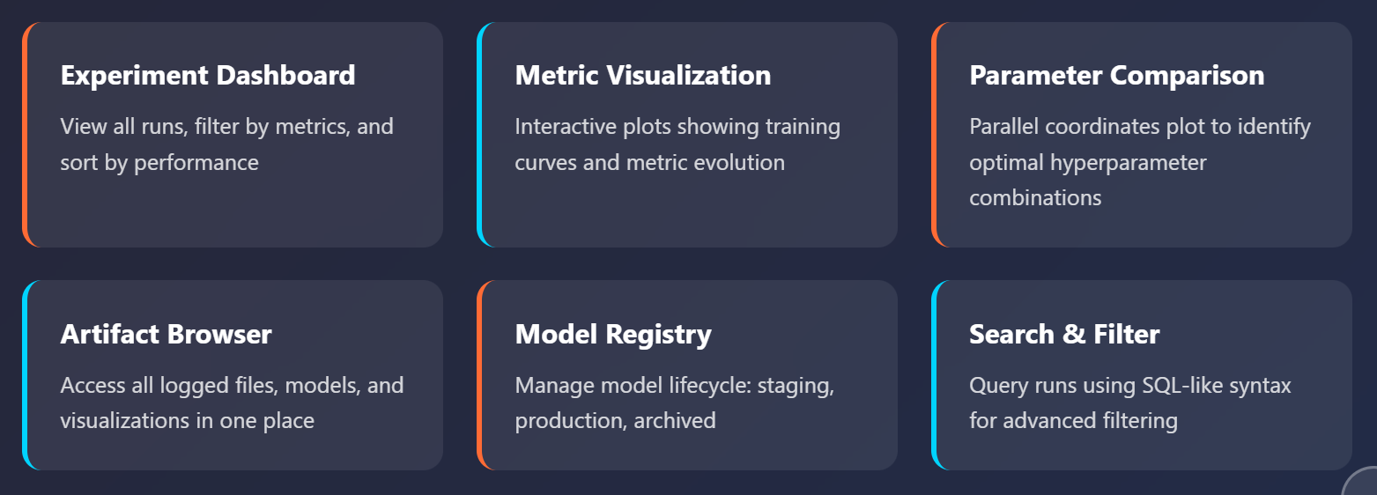
ML Flow UI Capabilities

Slide 21
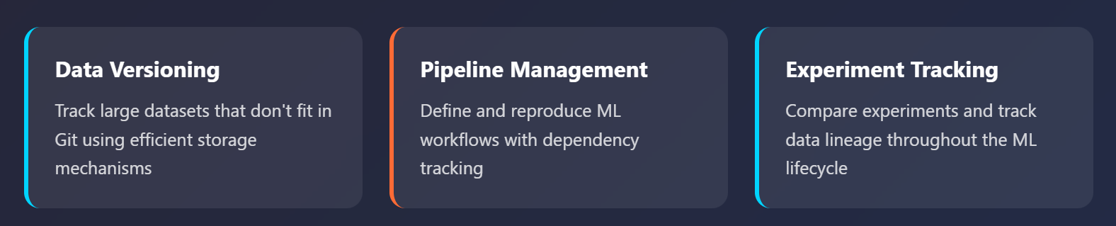
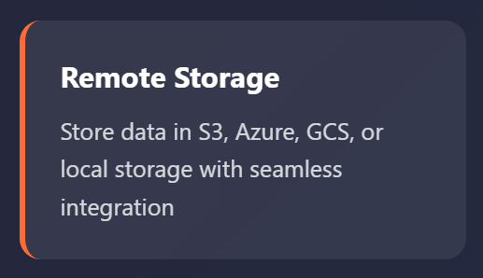
Data Version Control
Git for Data & ML Pipelines

Slide 22
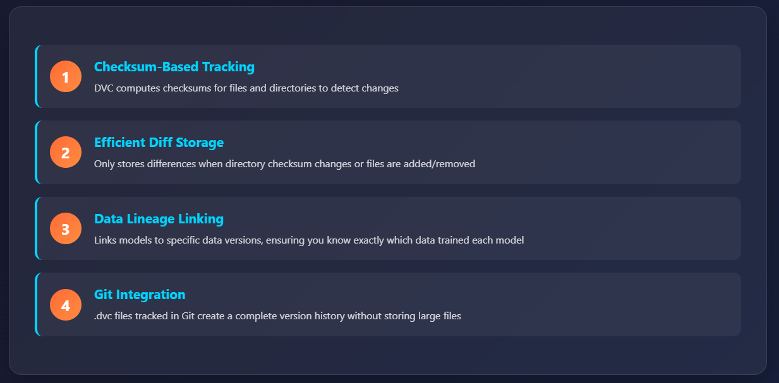
How DVC Tracks Data Versions

Slide 23
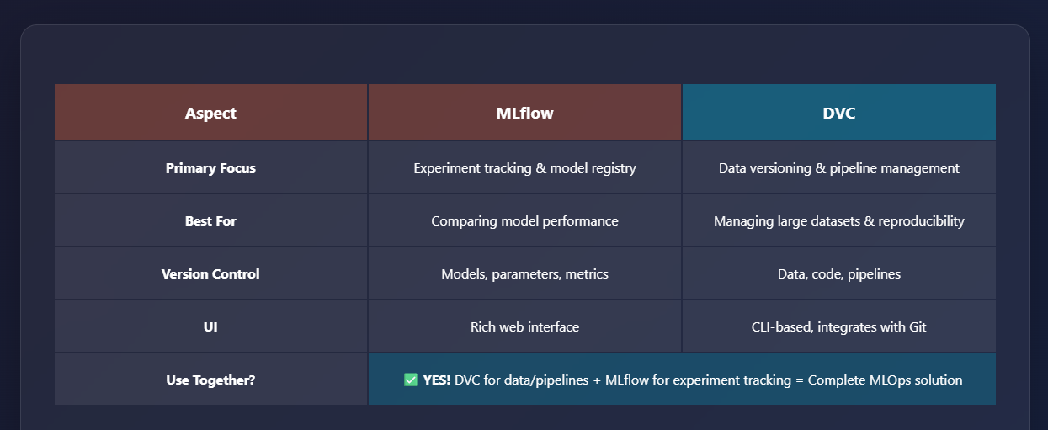
MLflow vs DVC: When to Use What?

Slide 24
How DVC Tracks Data Versions
Regression Project Development Sprint
Feature engineering experiments
Model hyperparameter optimization
Experiment tracking implementation
Performance improvement strategies

Slide 25
Assignment
Continue refining regression model
Log all experiments in Mlflow
Aim for best possible performance
Prepare project summary (problem, approach, results, challenges)

Slide 26
Thank You!

